Slide 1
IKitchen
How hungry are you ?
An application developed by
Bisconti Flavian
Pire Nathan
Zaretti Quentin

Slide 2

What is IKitchen ?
Web application
Cooking Website
Online booking platform
Friendly sharing forum

Slide 3
Who was it designed by ? In what context ?
Who ?
Computer science students
Aspiring anylist-programmers
What context ?
Multidisciplinary group project
2nd year June finals

Slide 4
What are the steps that were followed ?
The analysis
UML diagrams design
Class structure and association
Labour division
Meeting scheduling
Idea development
Analysis file writing
The programming
GitHub creation
Class implementation
Asp.Net use
Entity Framework

Slide 5
The UML diagrams
Three axes : fonctional, static and dynamic

Slide 6
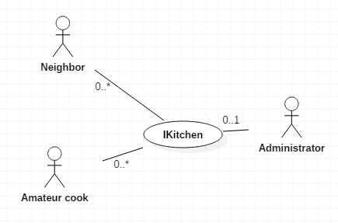
The Functional Axe
Static context diagram

Slide 7
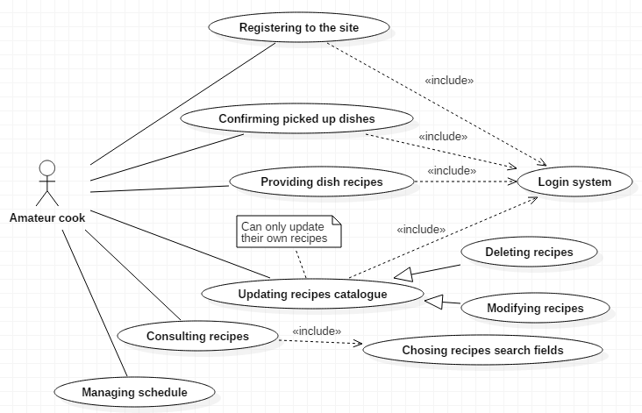
The Functional Axe
Cook usecase diagram

Slide 8
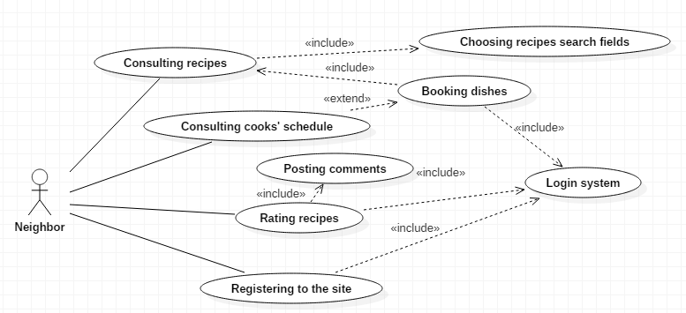
The Functional Axe
Neighbor usecase diagram

Slide 9
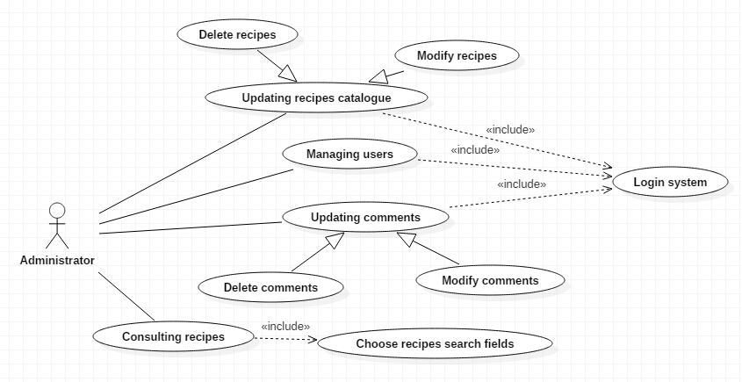
The Functional Axe
Admin usecase diagram

Slide 10
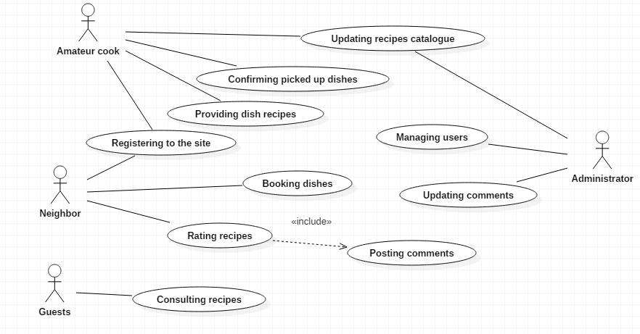
The Functional Axe
Summarized usecase diagram

Slide 11
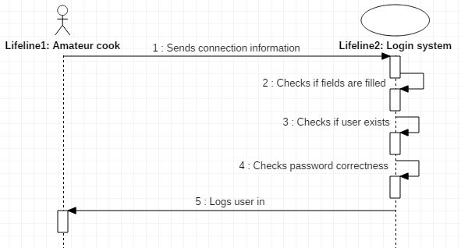
The Functional Axe
Login sequence diagram
Nominal
Alternative
Exception

Slide 12
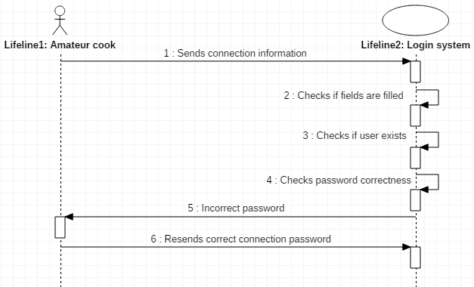
The Functional Axe
Login sequence diagram
Nominal
Alternative
Exception

Slide 13
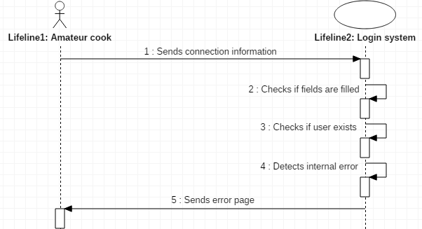
The Functional Axe
Login sequence diagram
Nominal
Alternative
Exception

Slide 14
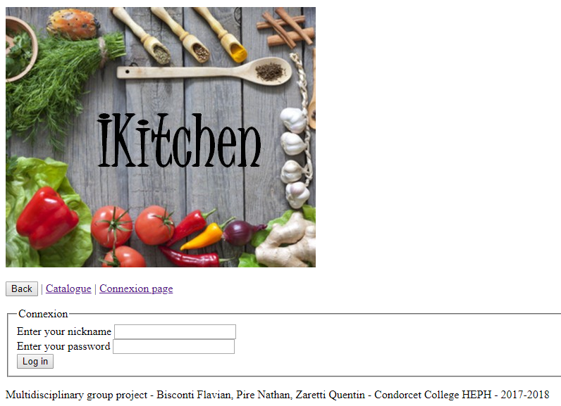
The Static Axe
Four iterations
Registering
Booking/Catalogue
Uploading
Administration
Establishment of partial class diagrams

Slide 15
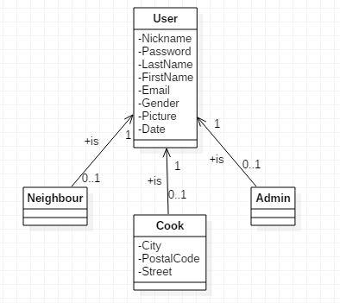
The Static Axe
Registering and administration
User’s group automatically determined at the connexion

Slide 16
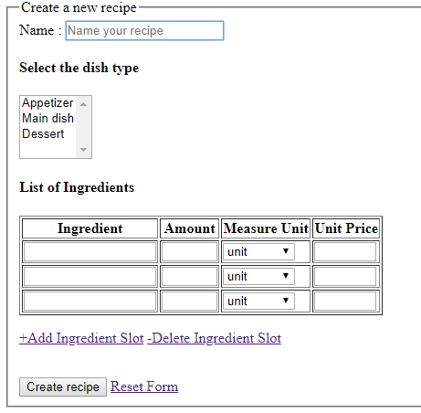
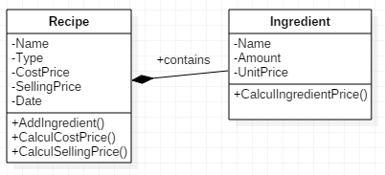
The Static Axe
Recipe uploading

Slide 17
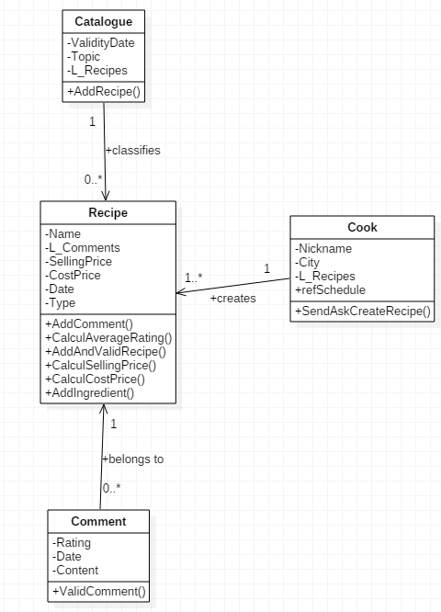
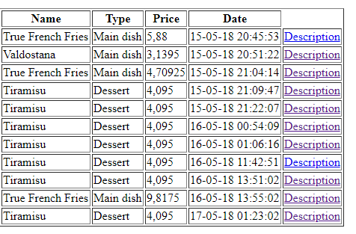
The Static Axe
Catalogue and booking

Slide 18
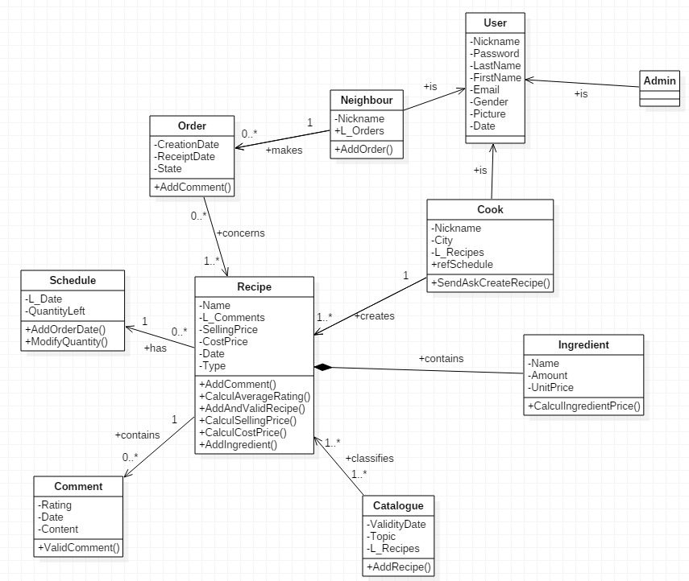
The Static Axe
Class diagram

Slide 19
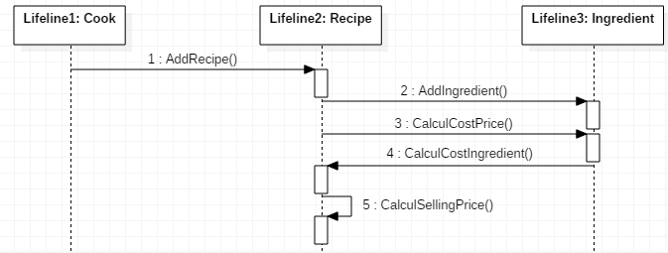
The Dynamic Axe
Providing dish recipe : analytical sequence diagram

